Slide 1
Transaction processing & Concurrency control
Dr. Manjiree Mukesh Vywahare

Slide 2
Concept of transaction
The concept of transaction provides a mechanism for describing logical units of database processing.
Transaction processing systems are systems with large databases and hundreds of concurrent users executing database transactions.
Examples of such systems include airline reservations, banking, credit card processing, online retail purchasing, stock markets, supermarket checkouts, and many other applications.
These systems require high availability and fast response time for hundreds of concurrent users.
A transaction is typically implemented by a computer program, which includes database commands such as retrievals, insertions, deletions, and updates.
Notes:
From book pdf

Slide 3
Single-User versus Multiuser Systems One criterion for classifying a database system is according to the number of users who can use the system concurrently.
A DBMS is single-user if at most one user at a time can use the system, and it is multiuser if many users can use the system
and hence access the database—concurrently.
Single-user DBMSs are mostly restricted to personal computer systems;
most other DBMSs are multiuser.
For example, an airline reservations system is used by hundreds of travel agents and reservation clerks concurrently.
Database systems used in banks, insurance agencies, stock exchanges, supermarkets, and many other applications are multiuser systems.
In these systems, hundreds or thousands of users are typically operating on the database by submitting transactions concurrently to the system.
Multiple users can access databases—and use computer systems—simultaneously because of the concept of multiprogramming,
which allows the operating system of the computer to execute multiple programs—or processes—at the same time.
A single central processing unit (CPU) can only execute at most one process at a time.
However, multiprogramming operating systems execute some commands from one process, then suspend that process and execute some commands from the next

Slide 4
process, and so on. A process is resumed at the point where it was suspended whenever it gets its turn to use the CPU again.
Hence, concurrent execution of processes is actually interleaved, as illustrated in Figure 21.1,
which shows two processes, A and B, executing concurrently in an interleaved fashion.
Interleaving keeps the CPU busy when a process requires an input or output (I/O) operation, such as reading a block from disk.
The CPU is switched to execute another process rather than remaining idle during I/O time. Interleaving also prevents a long process from delaying other processes.
If the computer system has multiple hardware processors (CPUs), parallel processing of multiple processes is possible, as illustrated by processes C and D in Figure 21.1.
Most of the theory concerning concurrency control in databases is developed in terms of interleaved concurrency, so for the remainder of this chapter we assume this model. In a multiuser DBMS, the stored data items are the primary resources that may be accessed concurrently by interactive users or application programs, which are constantly retrieving information from and modifying the database

Slide 5
A transaction is an executing program that forms a logical unit of database processing.
A transaction includes one or more database access operations—these can include insertion, deletion, modification, or retrieval operations.
The database operations that form a transaction can either be embedded within an application program or they can be specified interactively via a high-level query language such as SQL.
One way of specifying the transaction boundaries is by specifying explicit begin transaction and end transaction statements in an application program;
in this case, all database access operations between the two are considered as forming one transaction.
A single application program may contain more than one transaction if it contains several transaction boundaries.
If the database operations in a transaction do not update the database but only retrieve data, the transaction is called a read-only transaction; otherwise it is known as a read-write transaction
Notes:
Pdf book file:///D:/advance%20dbms/Fundamentals_of_Database_Systems,_6th_Edition.pdf

Slide 6
A database is basically represented as a collection of named data items.
The size of a data item is called its granularity.
A data item can be a database record, but it can also be a larger unit such as a whole disk block, or even a smaller unit such as an individual field (attribute) value of some record in the database.
The transaction processing concepts we discuss are independent of the data item granularity (size) and apply to data items in general.
Each data item has a unique name, but this name is not typically used by the programmer; rather, it is just a means to uniquely identify each data item
For example, if the data item granularity is one disk block, then the disk block address can be used as the data item name.
Using this simplified database model, the basic database access operations that a transaction can include are as follows:
read_item(X). Reads a database item named X into a program variable. To simplify our notation, we assume that the program variable is also named X.
write_item(X). Writes the value of program variable X into the database item named X.

Slide 7
Executing a read_item(X) command includes the following steps:
1. Find the address of the disk block that contains item X.
2. Copy that disk block into a buffer in main memory (if that disk block is not already in some main memory buffer).
3. Copy item X from the buffer to the program variable named X.
Executing a write_item(X) command includes the following steps:
1. Find the address of the disk block that contains item X.
2. Copy that disk block into a buffer in main memory (if that disk block is not already in some main memory buffer).
3. Copy item X from the program variable named X into its correct location in the buffer.
4. Store the updated block from the buffer back to disk (either immediately or at some later point in time).

Slide 8
It is step 4 that actually updates the database on disk.
In some cases the buffer is not immediately stored to disk, in case additional changes are to be made to the buffer.
Usually, the decision about when to store a modified disk block whose contents are in a main memory buffer is handled by the recovery manager of the DBMS in cooperation with the underlying operating system.
The DBMS will maintain in the database cache a number of data buffers in main memory.
Each buffer typically holds the contents of one database disk block, which contains some of the database items being processed.
When these buffers are all occupied, and additional database disk blocks must be copied into memory, some buffer replacement policy is used to choose which of the current buffers is to be replaced.

Slide 9
If the chosen buffer has been modified, it must be written back to disk before it is reused.
A transaction includes read_item and write_item operations to access and update the database.
The read-set of a transaction is the set of all items that the transaction reads, and the write-set is the set of all items that the transaction writes.
For example, the read-set of T1 in {X, Y} and
its write-set is also {X, Y}. Concurrency control and recovery mechanisms are mainly concerned with the database commands in a transaction.
Transactions submitted by the various users may execute concurrently and may access and update the same database items.
If this concurrent execution is uncontrolled, it may lead to problems, such as an inconsistent database. 1026

Slide 10
Why Concurrency Control Is Needed?
Concurrency Control Is Needed : because Several problems can occur when concurrent transactions execute in an uncontrolled manner.
Lets take example of airline reservations database in which a record is stored for each airline flight.
Each record includes the number of reserved seats on that flight as a named (uniquely identifiable) data item, among other information
transaction T1 that transfers N reservations from one flight whose number of reserved seats is stored in the database item named X to another flight whose number of reserved seats is stored in the database item named Y.
transaction T2 that just reserves M seats on the first flight (X) referenced in transaction T1.
To simplify our example, we do not show additional portions of the transactions, such as checking whether a flight has enough seats available before reserving additional seat

Slide 11
When a database access program is written, it has the flight number, flight date, and the number of seats to be booked as parameters;
hence, the same program can be used to execute many different transactions, each with a different flight number, date, and number of seats to be booked.
For concurrency control purposes, a transaction is a particular execution of a program on a specific date, flight, and number of seats.
transactions T1 and T2 are specific executions of the programs that refer to the specific flights whose numbers of seats are stored in data items X and Y in the database.

Slide 12
1. The Lost Update Problem
The Lost Update Problem. This problem occurs when two transactions that access the same database items have their operations interleaved in a way that makes the value of some database items incorrect.
Suppose that transactions T1 and T2 are submitted at approximately the same time, and
suppose that their operations are interleaved then the final value of item X is incorrect because T2 reads the value of X before T1 changes it in the database, and hence the updated value resulting from T1 is lost.
For example, if X = 80 at the start (originally there were 80 reservations on the flight), N = 5 (T1 transfers 5 seat reservations from the flight corresponding to X to the flight corresponding to Y), and M = 4 (T2 reserves 4 seats on X), the final result should be X = 79. However, in the interleaving of operations, it is X = 84 because the update in T1 that removed the five seats from X was lost.

Slide 13
2. The Temporary Update (or Dirty Read) Problem
The Temporary Update (or Dirty Read) Problem.
This problem occurs when one transaction updates a database item and then the transaction fails for some reason.
Meanwhile, the updated item is accessed (read) by another transaction before it is changed back to its original value.
where T1 updates item X and then fails before completion, so the system must change X back to its original value.
Before it can do so, however, transaction T2 reads the temporary value of X, which will not be recorded permanently in the database because of the failure of T1.
The value of item X that is read by T2 is called dirty data because it has been created by a transaction that has not completed and committed yet;
hence, this problem is also known as the dirty read problem

Slide 14
3. The Incorrect Summary Problem
If one transaction is calculating an aggregate summary function on a number of database items while other transactions are updating some of these items,
the aggregate function may calculate some values before they are updated and others after they are updated.
For example, suppose that a transaction T3 is calculating the total number of reservations on all the flights; meanwhile, transaction T1 is executing. If the interleaving of operations occurs, the result of T3 will be off by an amount N because T3 reads the value of X after N seats have been subtracted from it but reads the value of Y before those N seats have been added to it
Notes:
Interleaving= blank paper in between the pages for notes purpose

Slide 15
4. The Unrepeatable Read Problem
Another problem that may occur is called unrepeatable read, where a transaction T reads the same item twice and the item is changed by another transaction T between the two reads.
Hence, T receives different values for its two reads of the same item. This may occur, for example,
if during an airline reservation transaction, a customer inquires about seat availability on several flights.
When the customer decides on a particular flight, the transaction then reads the number of seats on that flight a second time before completing the reservation, and it may end up reading a different value for the item.

Slide 16
Why Recovery Is Needed?
Why Recovery Is Needed Whenever a transaction is submitted to a DBMS for execution,
the system is responsible for making sure that either all the operations in the transaction are completed successfully and their effect is recorded permanently in the database, or that the transaction does not have any effect on the database or any other transactions.
In the first case, the transaction is said to be committed,
whereas in the second case, the transaction is aborted.
The DBMS must not permit some operations of a transaction T to be applied to the database while other operations of T are not, because the whole transaction is a logical unit of database processing.
If a transaction fails after executing some of its operations but before executing all of them, the operations already executed must be undone and have no lasting effect

Slide 17
Types of Failures.
Types of Failures. Failures are generally classified as transaction, system, and media failures. There are several possible reasons for a transaction to fail in the middle of execution:
1. A computer failure (system crash). A hardware, software, or network error occurs in the computer system during transaction execution. Hardware crashes are usually media failures—for example, main memory failure.
2. A transaction or system error. Some operation in the transaction may cause it to fail, such as integer overflow or division by zero. Transaction failure may also occur because of erroneous parameter values or because of a logical programming error. Additionally, the user may interrupt the transaction during its execution.
3. Local errors or exception conditions detected by the transaction. During transaction execution, certain conditions may occur that necessitate cancellation of the transaction. For example, data for the transaction may not be found. An exception condition
4 such as insufficient account balance in a banking database, may cause a transaction, such as a fund withdrawal, to be canceled.
This exception could be programmed in the transaction itself, and in such a case would not be considered as a transaction failure

Slide 18
4. Concurrency control enforcement. The concurrency control method may decide to abort a transaction because it violates serializability, or it may abort. one or more transactions to resolve a state of deadlock among several transactions. Transactions aborted because of serializability violations or deadlocks are typically restarted automatically at a later time.
5. Disk failure. Some disk blocks may lose their data because of a read or write malfunction or because of a disk read/write head crash. This may happen during a read or a write operation of the transaction.
6. Physical problems and catastrophes. This refers to an endless list of problems that includes power or air-conditioning failure, fire, theft, sabotage, overwriting disks or tapes by mistake, and mounting of a wrong tape by the operator.
Failures of types 1, 2, 3, and 4 are more common than those of types 5 or 6. Whenever a failure of type 1 through 4 occurs, the system must keep sufficient information to quickly recover from the failure. Disk failure or other catastrophic failures of type 5 or 6 do not happen frequently; if they do occur, recovery is a major task. The concept of transaction is fundamental to many techniques for concurrency control and recovery from failures

Slide 19
1 Transaction States and Additional Operations
1 Transaction States and Additional Operations A transaction is an atomic unit of work that should either be completed in its entirety or not done at all. For recovery purposes, the system needs to keep track of when each transaction starts, terminates, and commits or aborts.
Therefore, the recovery manager of the DBMS needs to keep track of the following operations:
■ BEGIN_TRANSACTION. This marks the beginning of transaction execution.
■ READ or WRITE. These specify read or write operations on the database items that are executed as part of a transaction.
■ END_TRANSACTION. This specifies that READ and WRITE transaction operations have ended and marks the end of transaction execution.
However, at this point it may be necessary to check whether the changes introduced by

Slide 20
the transaction can be permanently applied to the database (committed) or whether the transaction has to be aborted because it violates serializability or for some other reason.
■ COMMIT_TRANSACTION. This signals a successful end of the transaction so that any changes (updates) executed by the transaction can be safely committed to the database and will not be undone
■ ROLLBACK (or ABORT). This signals that the transaction has ended unsuccessfully, so that any changes or effects that the transaction may have applied to the database must be undone

Slide 21
A transaction goes into an active state immediately after it starts execution, where it can execute its READ and WRITE operations. When the transaction ends, it moves to the partially committed state.
At this point, some recovery protocols need to ensure that a system failure will not result in an inability to record the changes of the transaction permanently (usually by recording changes in the system log)
Once this check is successful, the transaction is said to have reached its commit point and enters the committed state.
When a transaction is committed, it has concluded its execution successfully and all its changes must be recorded permanently in the database, even if a system failure occurs

Slide 22
However, a transaction can go to the failed state if one of the checks fails or if the transaction is aborted during its active state.
The transaction may then have to be rolled back to undo the effect of its WRITE operations on the database.
The terminated state corresponds to the transaction leaving the system. The transaction information that is maintained in system tables while the transaction has been running is removed when the transaction terminates.
Failed or aborted transactions may be restarted later—either automatically or after being resubmitted by the user—as brand new transactions.

Slide 23
State transition diagram illustrating the states for transaction execution.
Read , Write
Begin Transaction
End Transaction
Active
Partially committed
Commit
Committed
Abort
Abort
Failed
Terminated

Slide 24
Transaction Means
The transaction is a set of logically related operation. It contains a group of tasks.
A transaction is an action or series of actions. It is performed by a single user to perform operations for accessing the contents of the database.
Example: Suppose an employee of bank transfers Rs 800 from X's account to Y's account. This small transaction contains several low-level tasks:
Notes:
https://www.javatpoint.com/dbms-transaction-property

Slide 25
X account
Open_Account(X)
Old_Balance = X.balance
New_Balance = Old_Balance - 800
X.balance = New_Balance
Close_Account(X)

Slide 26
Y’s Account
Open_Account(Y)
Old_Balance = Y.balance
New_Balance = Old_Balance + 800
Y.balance = New_Balance
Close_Account(Y)

Slide 27
Operations of Transaction:
Following are the main operations of transaction:
Read(X): Read operation is used to read the value of X from the database and stores it in a buffer in main memory.
Write(X): Write operation is used to write the value back to the database from the buffer.
Let's take an example to debit transaction from an account which consists of following operations:

Slide 28
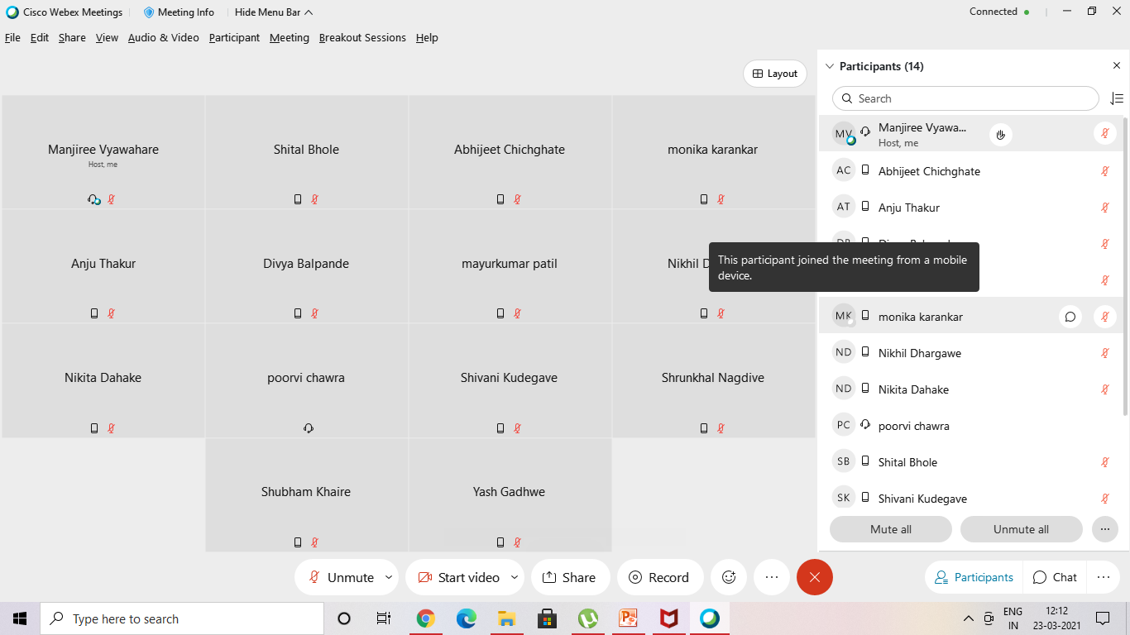
23/03/21 two lect

Slide 29
Operations of Transaction:
Following are the main operations of transaction:
Read(X): Read operation is used to read the value of X from the database and stores it in a buffer in main memory.
Write(X): Write operation is used to write the value back to the database from the buffer.
Let's take an example to debit transaction from an account which consists of following operations:
1. R(X);
2. X = X - 500;
3. W(X);
Let's assume the value of X before starting of the transaction is 4000.
The first operation reads X's value from database and stores it in a buffer.
The second operation will decrease the value of X by 500. So buffer will contain 3500.
The third operation will write the buffer's value to the database. So X's final value will be 3500.

Slide 30
But it may be possible that because of the failure of hardware, software or power, etc. that transaction may fail before finished all the operations in the set.
For example: If in the above transaction, the debit transaction fails after executing operation 2 then X's value will remain 4000 in the database which is not acceptable by the bank.
To solve this problem, we have two important operations:
Commit: It is used to save the work done permanently.
Rollback: It is used to undo the work done.

Slide 31
ACID Properties A transaction is a unit of program execution that accesses and possibly updates various data items. To preserve the integrity of data the database system must ensure:
Atomicity. Either all operations of the transaction are properly reflected in the database or none are.
Consistency. Execution of a transaction in isolation preserves the consistency of the database.
Isolation. Although multiple transactions may execute concurrently, each transaction must be unaware of other concurrently executing transactions. Intermediate transaction results must be hidden from other concurrently executed transactions.
That is, for every pair of transactions T_{i} and T_{j}, it appears to T_{i} that either T_{j}, finished execution before T_{i} started, or T_{j} started execution after T_{i} finished.
Durability. After a transaction completes successfully, the changes it has made to the database persist, even if there are system failures.
Notes:
consistency = uniformality , stadyness, reliability persist=continue keep it up

Slide 32
Transaction Concept
A transaction is a unit of program execution that accesses and possibly updates various data items.
E.g., transaction to transfer $50 from account A to account B:
1. read(A)
2. A := A – 50
3. write(A)
4. read(B)
5. B := B + 50
6. write(B)
Two main issues to deal with:
Failures of various kinds, such as hardware failures and system crashes
Concurrent execution of multiple transactions

Slide 33
requirements
Atomicity requirement
If the transaction fails after step 3 and before step 6, money will be “lost” leading to an inconsistent database state
Failure could be due to software or hardware
The system should ensure that updates of a partially executed transaction are not reflected in the database
Durability requirement — once the user has been notified that the transaction has completed (i.e., the transfer of the $50 has taken place), the updates to the database by the transaction must persist even if there are software or hardware failures
Consistency requirement in above example:
The sum of A and B is unchanged by the execution of the transaction
In general, consistency requirements include
Explicitly specified integrity constraints such as primary keys and foreign keys
Implicit integrity constraints
e.g., sum of balances of all accounts, minus sum of loan amounts must equal value of cash-in-hand
A transaction, when starting to execute, must see a consistent database.
During transaction execution the database may be temporarily inconsistent.
When the transaction completes successfully the database must be consistent
Erroneous transaction logic can lead to inconsistency

Slide 34
Isolation requirement — if between steps 3 and 6 (of the fund transfer transaction) , another transaction T2 is allowed to access the partially updated database, it will see an inconsistent database (the sum A + B will be less than it should be).
T1 T2
1. read(A)
2. A := A – 50
3. write(A) read(A), read(B), print(A+B)
4. read(B)
5. B := B + 50
6. write(B
Isolation can be ensured trivially by running transactions serially
That is, one after the other.
However, executing multiple transactions concurrently has significant benefits, as we will see later.

Slide 35
Transaction State
Active – the initial state; the transaction stays in this state while it is executing
Partially committed – after the final statement has been executed.
Failed -- after the discovery that normal execution can no longer proceed.
Aborted – after the transaction has been rolled back and the database restored to its state prior to the start of the transaction. Two options after it has been aborted:
Restart the transaction
can be done only if no internal logical error
Kill the transaction
Committed – after successful completion.

Slide 36
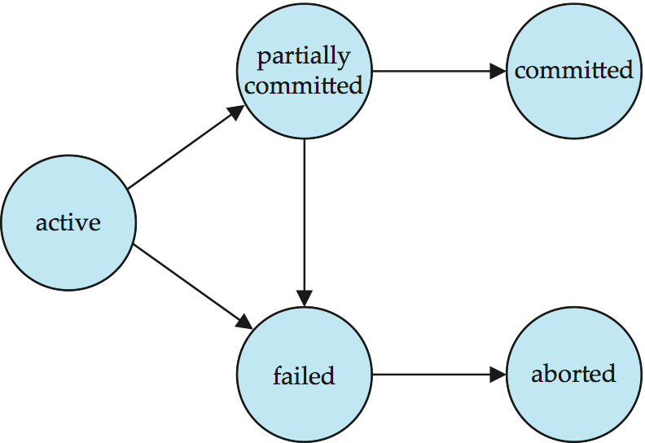
Transaction State (Cont.)

Slide 37
Concurrent Executions
Multiple transactions are allowed to run concurrently in the system. Advantages are:
Increased processor and disk utilization, leading to better transaction throughput
E.g. one transaction can be using the CPU while another is reading from or writing to the disk
Reduced average response time for transactions: short transactions need not wait behind long ones.
Concurrency control schemes – mechanisms to achieve isolation
That is, to control the interaction among the concurrent transactions in order to prevent them from destroying the consistency of the database

Slide 38
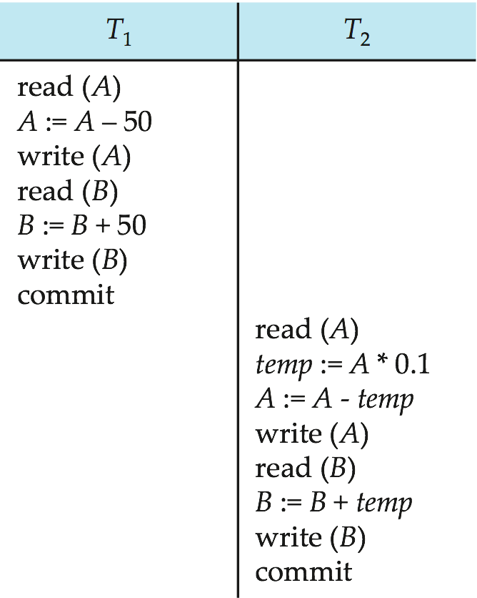
Schedule 1
Let T₁ transfer $50 from A to B, and T₂ transfer 10% of the balance from A to B.
An example of a serial schedule in which T₁ is followed by T₂ :

Slide 39
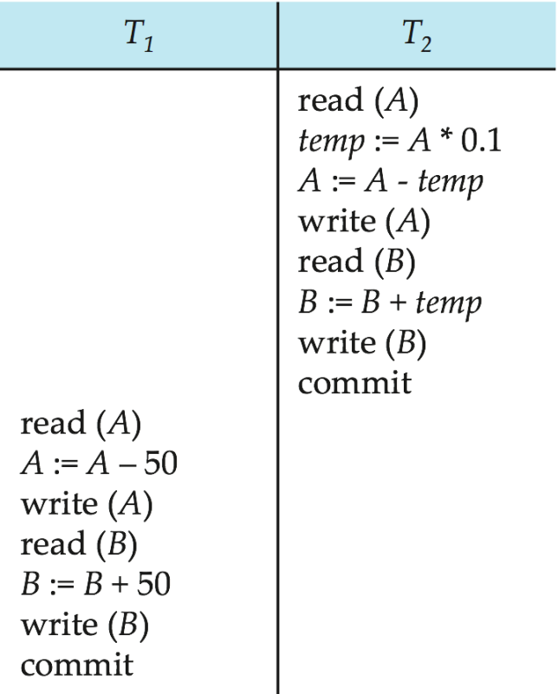
Schedule 2
A serial schedule in which T₂ is followed by T₁ :

Slide 40
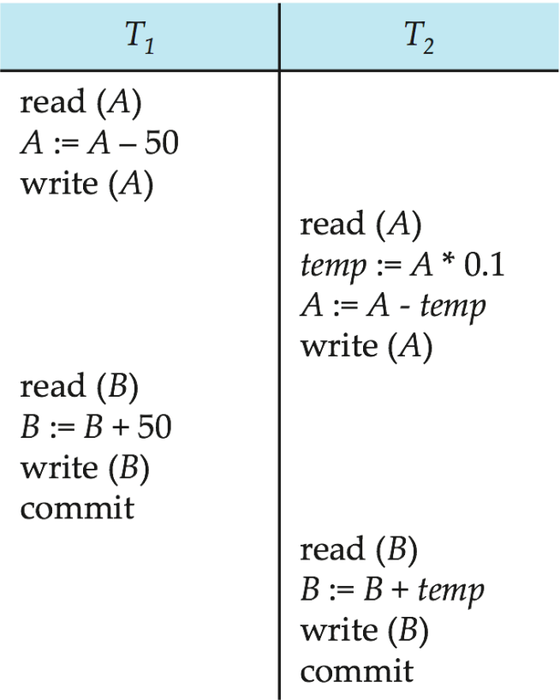
Schedule 3
Let T₁ and T₂ be the transactions defined previously. The following schedule is not a serial schedule, but it is equivalent to Schedule 1.
Note -- In schedules 1, 2 and 3, the sum “A + B” is preserved.

Slide 41
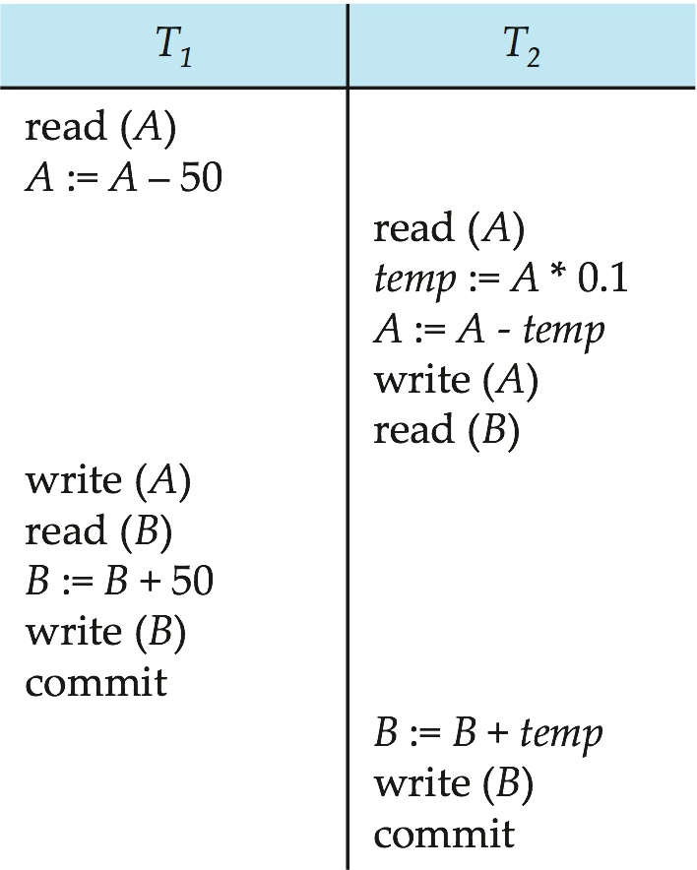
Schedule 4
The following concurrent schedule does not preserve the sum of “A + B”

Slide 42
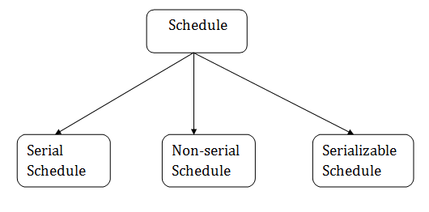
Schedule
A series of operation from one transaction to another transaction is known as schedule.
It is used to preserve the order of the operation in each of the individual transaction.
Notes:
https://www.javatpoint.com/dbms-view-serializability

Slide 43
Schedule
1. Serial Schedule
The serial schedule is a type of schedule where one transaction is executed completely before starting another transaction. In the serial schedule, when the first transaction completes its cycle, then the next transaction is executed.
For example: Suppose there are two transactions T1 and T2 which have some operations. If it has no interleaving of operations, then there are the following two possible outcomes:
Execute all the operations of T1 which was followed by all the operations of T2.
Execute all the operations of T1 which was followed by all the operations of T2.
In the given (a) figure, Schedule A shows the serial schedule where T1 followed by T2.
In the given (b) figure, Schedule B shows the serial schedule where T2 followed by T1.

Slide 44
2. Non-serial Schedule
If interleaving of operations is allowed, then there will be non-serial schedule.
It contains many possible orders in which the system can execute the individual operations of the transactions.
In the given figure (c) and (d), Schedule C and Schedule D are the non-serial schedules. It has interleaving of operations.

Slide 45
3. Serializable schedule
The serializability of schedules is used to find non-serial schedules that allow the transaction to execute concurrently without interfering with one another.
It identifies which schedules are correct when executions of the transaction have interleaving of their operations.
A non-serial schedule will be serializable if its result is equal to the result of its transactions executed serially

Slide 46
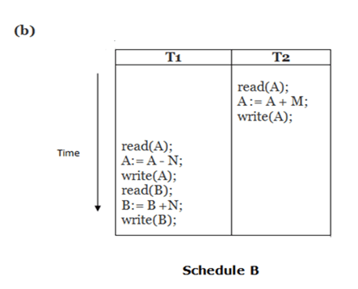
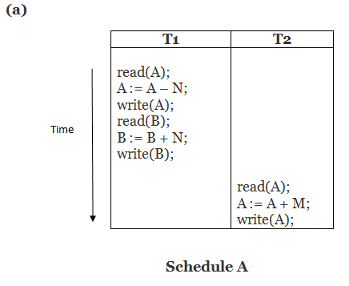

Slide 47
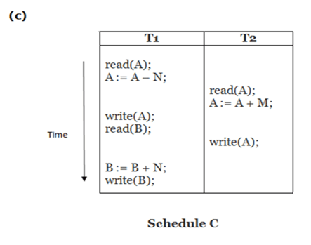
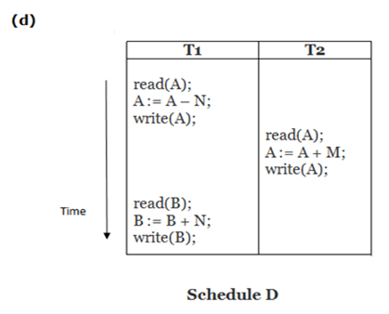
Here,
Schedule A and Schedule B are serial schedule.
Schedule C and Schedule D are Non-serial schedule.

Slide 48
What is serialization?
When multiple transactions are running concurrently then there is a possibility that the database may be left in an inconsistent state.
Serializability is a concept that helps us to check which schedules are serializable.
A serializable schedule is the one that always leaves the database in consistent state.

Slide 49
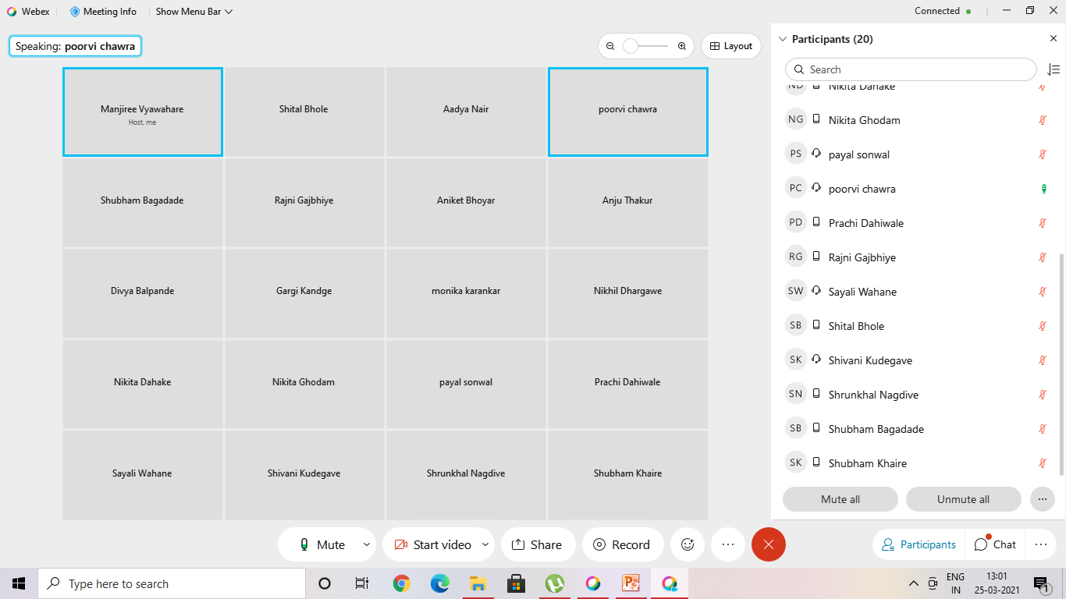
25/03/21 due to network problem

Slide 50
Testing of Serializability
Serialization Graph is used to test the Serializability of a schedule.
Assume a schedule S.
For S, we construct a graph known as precedence graph. This graph has a pair G = (V, E), where V consists a set of vertices, and E consists a set of edges. The set of vertices is used to contain all the transactions participating in the schedule. The set of edges is used to contain all edges Ti ->Tj for which one of the three conditions holds:
Create a node Ti → Tj if Ti executes write (Q) before Tj executes read (Q).
Create a node Ti → Tj if Ti executes read (Q) before Tj executes write (Q).
Create a node Ti → Tj if Ti executes write (Q) before Tj executes write (Q).
If a precedence graph contains a single edge Ti → Tj, then all the instructions of Ti are executed before the first instruction of Tj is executed.
If a precedence graph for schedule S contains a cycle, then S is non-serializable. If the precedence graph has no cycle, then S is known as serializable.

Slide 51
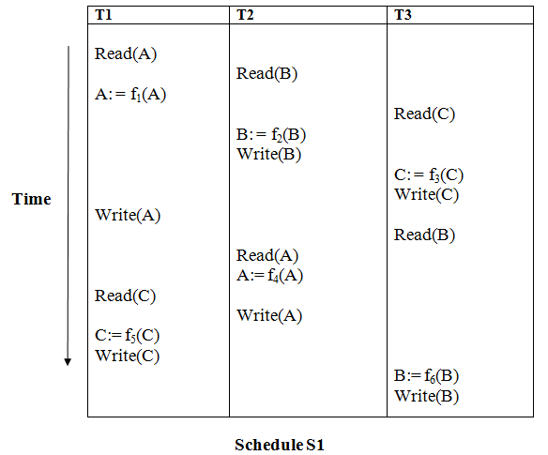

Slide 52
Explanation:
Read(A): In T1, no subsequent writes to A, so no new edges Read(B): In T2, no subsequent writes to B, so no new edges Read(C): In T3, no subsequent writes to C, so no new edges Write(B): B is subsequently read by T3, so add edge T2 → T3 Write(C): C is subsequently read by T1, so add edge T3 → T1 Write(A): A is subsequently read by T2, so add edge T1 → T2 Write(A): In T2, no subsequent reads to A, so no new edges Write(C): In T1, no subsequent reads to C, so no new edges Write(B): In T3, no subsequent reads to B, so no new edges

Slide 53
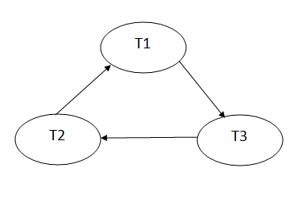
Precedence graph for schedule S1:
The precedence graph for schedule S1 contains a cycle that's why Schedule S1 is non-serializable.

Slide 54
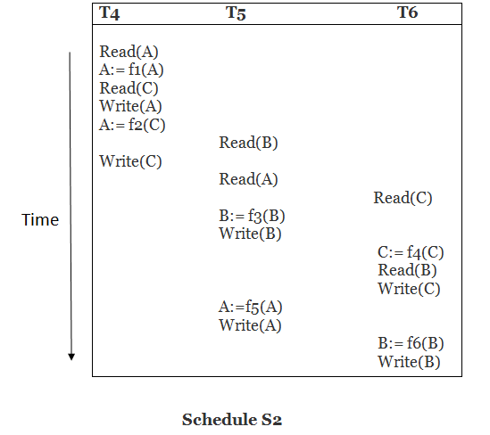
explanation:
Read(A): In T4,no subsequent writes to A, so no new edges Read(C): In T4, no subsequent writes to C, so no new edges Write(A): A is subsequently read by T5, so add edge T4 → T5 Read(B): In T5,no subsequent writes to B, so no new edges Write(C): C is subsequently read by T6, so add edge T4 → T6 Write(B): A is subsequently read by T6, so add edge T5 → T6 Write(C): In T6, no subsequent reads to C, so no new edges Write(A): In T5, no subsequent reads to A, so no new edges Write(B): In T6, no subsequent reads to B, so no new edges

Slide 55
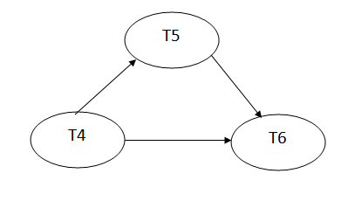
precedence graph for schedule S2:
The precedence graph for schedule S2 contains no cycle that's why ScheduleS2 is serializable.

Slide 56
Conflict Serializable Schedule
A schedule is called conflict serializability if after swapping of non-conflicting operations, it can transform into a serial schedule.
The schedule will be a conflict serializable if it is conflict equivalent to a serial schedule.
Conflicting Operations
The two operations become conflicting if all conditions satisfy:
Both belong to separate transactions.
They have the same data item.
They contain at least one write operation.

Slide 57
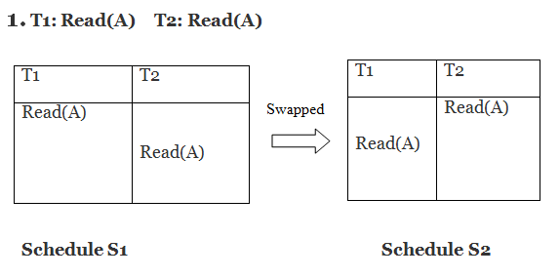
Example: Swapping is possible only if S1 and S2 are logically equal.
Here, S1 = S2. That means it is non-conflict.

Slide 58
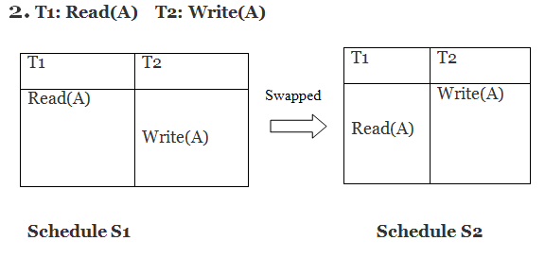
Here, S1 ≠ S2. That means it is conflict.

Slide 59
conflict equivalent
In the conflict equivalent, one can be transformed to another by swapping non-conflicting operations. In the given example, S2 is conflict equivalent to S1 (S1 can be converted to S2 by swapping non-conflicting operations).
Two schedules are said to be conflict equivalent if and only if:
They contain the same set of the transaction.
If each pair of conflict operations are ordered in the same way.

Slide 60
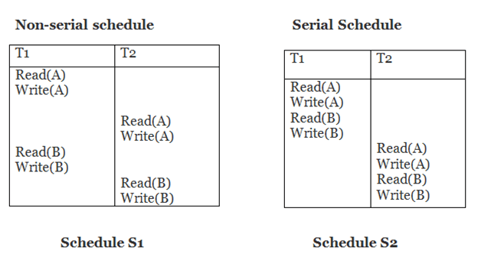
Schedule S2 is a serial schedule because, in this, all operations of T1 are performed before starting any operation of T2. Schedule S1 can be transformed into a serial schedule by swapping non-conflicting operations of S1.

Slide 61
After swapping of non-conflict operations, the schedule S1 becomes:
Since, S1 is conflict serializable.
T1 | T2
Read(A) Write(A) Read(B) Write(B) | Read(A) Write(A) Read(B) Write(B)

Slide 62
Serializability
Basic Assumption – Each transaction preserves database consistency.
Thus, serial execution of a set of transactions preserves database consistency.
A (possibly concurrent) schedule is serializable if it is equivalent to a serial schedule. Different forms of schedule equivalence give rise to the notions of:
1. conflict serializability
2. view serializability

Slide 63
Simplified view of transactions
We ignore operations other than read and write instructions
We assume that transactions may perform arbitrary computations on data in local buffers in between reads and writes.
Our simplified schedules consist of only read and write instructions.

Slide 64
Conflicting Instructions
Let l_{i} and l_{j} be two Instructions of transactions T_{i} and T_{j} respectively. Instructions l_{i} and l_{j} conflict if and only if there exists some item Q accessed by both l_{i} and l_{j}, and at least one of these instructions wrote Q.
1. l_{i} = read(Q), l_{j} = read(Q). l_{i} and l_{j} don’t conflict. 2. l_{i} = read(Q), l_{j} = write(Q). They conflict. 3. l_{i} = write(Q), l_{j} = read(Q). They conflict 4. l_{i} = write(Q), l_{j} = write(Q). They conflict
Intuitively, a conflict between l_{i} and l_{j} forces a (logical) temporal order between them.
If l_{i} and l_{j} are consecutive in a schedule and they do not conflict, their results would remain the same even if they had been interchanged in the schedule.
Notes:
Conflict=war clash fight

Slide 65
Conflict Serializability
If a schedule S can be transformed into a schedule S´ by a series of swaps of non-conflicting instructions, we say that S and S´ are conflict equivalent.
We say that a schedule S is conflict serializable if it is conflict equivalent to a serial schedule
Notes:
Conflict=fight

Slide 66
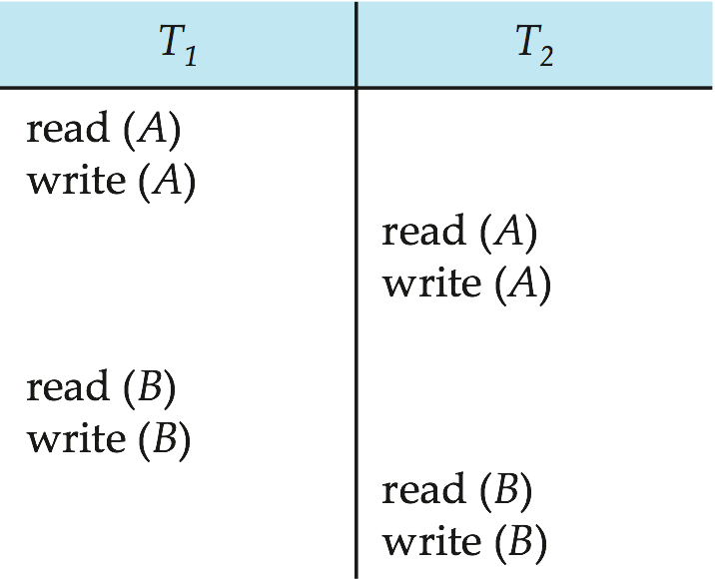
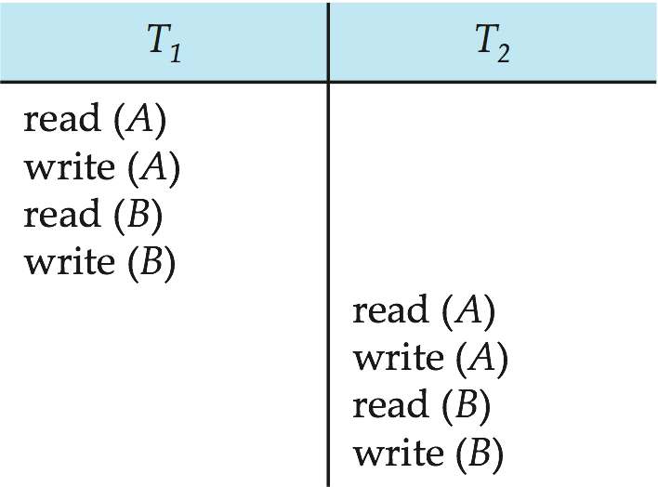
Conflict Serializability (Cont.)
Schedule 3 can be transformed into Schedule 6 -- a serial schedule where T₂ follows T₁, by a series of swaps of non-conflicting instructions. Therefore, Schedule 3 is conflict serializable.
Schedule 3
Schedule 6

Slide 67
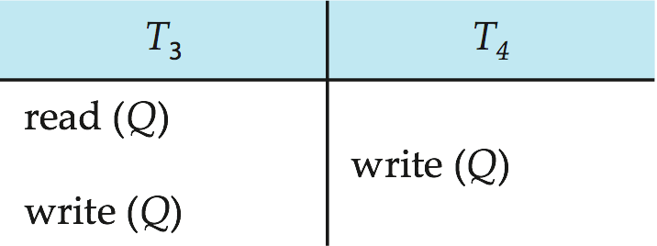
Conflict Serializability (Cont.)
Example of a schedule that is not conflict serializable:
We are unable to swap instructions in the above schedule to obtain either the serial schedule < T₃, T₄ >, or the serial schedule < T₄, T₃ >.

Slide 68
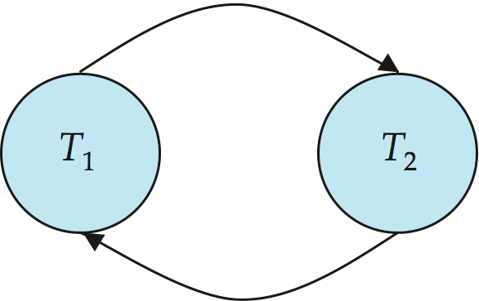
Precedence Graph
Consider some schedule of a set of transactions T₁, T₂, ..., T_{n}
Precedence graph — a direct graph where the vertices are the transactions (names).
We draw an arc from T_{i} to T_{j} if the two transaction conflict, and T_{i} accessed the data item on which the conflict arose earlier.
We may label the arc by the item that was accessed.
Example
Notes:
Arose=getup= ubharne

Slide 69
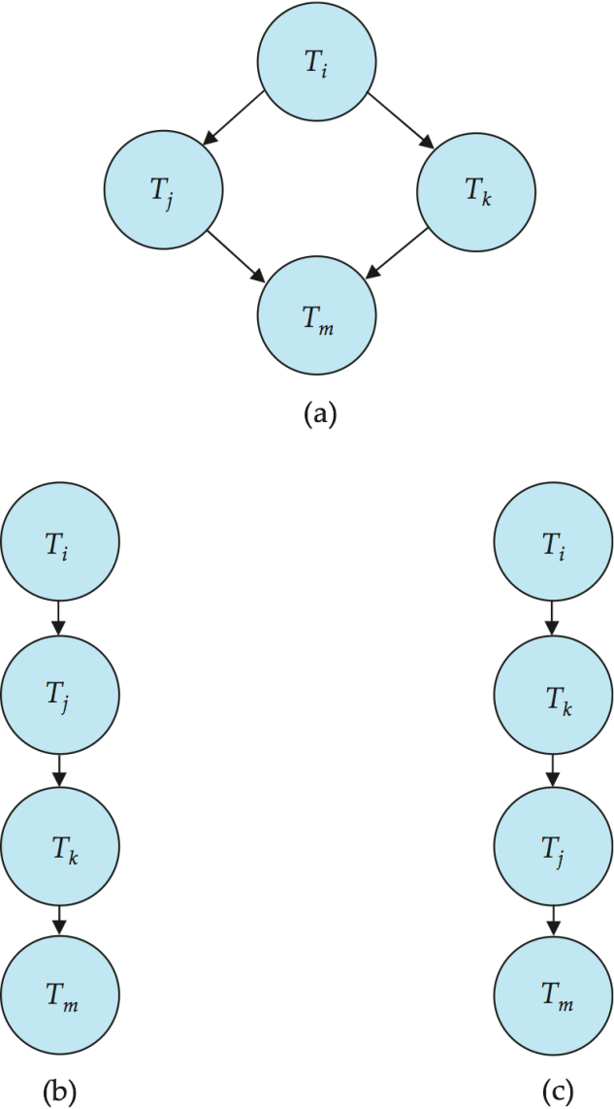
Testing for Conflict Serializability
A schedule is conflict serializable if and only if its precedence graph is acyclic.
Cycle-detection algorithms exist which take order n² time, where n is the number of vertices in the graph.
(Better algorithms take order n + e where e is the number of edges.)
If precedence graph is acyclic, the serializability order can be obtained by a topological sorting of the graph.
That is, a linear order consistent with the partial order of the graph.
For example, a serializability order for the schedule (a) would be one of either (b) or (c)

Slide 70
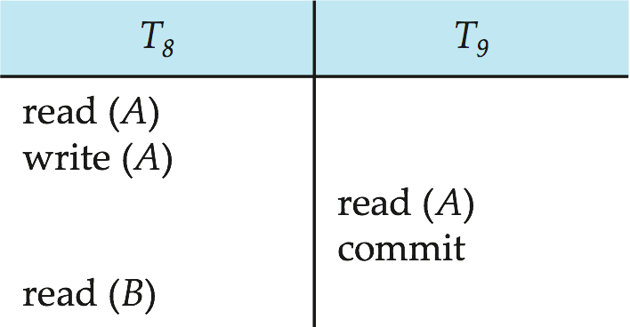
Recoverable Schedules
Recoverable schedule — if a transaction T_{j} reads a data item previously written by a transaction T_{i} , then the commit operation of T_{i} must appear before the commit operation of T_{j}.
The following schedule is not recoverable if T₉ commits immediately after the read(A) operation.
If T₈ should abort, T₉ would have read (and possibly shown to the user) an inconsistent database state. Hence, database must ensure that schedules are recoverable.

Slide 71
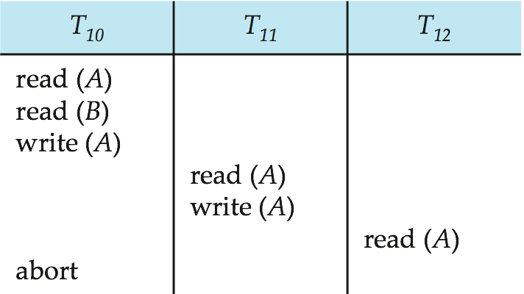
Cascading Rollbacks
Cascading rollback – a single transaction failure leads to a series of transaction rollbacks. Consider the following schedule where none of the transactions has yet committed (so the schedule is recoverable) If T₁₀ fails, T₁₁ and T₁₂ must also be rolled back.
Can lead to the undoing of a significant amount of work

Slide 72
Cascadeless Schedules
Cascadeless schedules — for each pair of transactions T_{i} and T_{j} such that T_{j} reads a data item previously written by T_{i}, the commit operation of T_{i} appears before the read operation of T_{j}.
Every cascadeless schedule is also recoverable
It is desirable to restrict the schedules to those that are cascadeless
Example of a schedule that is NOT cascadeless

Slide 73
Dirty read. A transaction T1 may read the update of a transaction T2, which has not yet committed. If T2 fails and is aborted, then T1 would have read a value that does not exist and is incorrect.
2. Nonrepeatable read. A transaction T1 may read a given value from a table. If another transaction T2 later updates that value and T1 reads that value again, T1 will see a different value. 3. Phantoms. A transaction T1 may read a set of rows from a table, perhaps based on some condition specified in the SQL WHERE-clause. Now suppose that a transaction T2 inserts a new row that also satisfies the WHERE-clause condition used in T1, into the table used by T1. If T1 is repeated, then T1 will see a phantom, a row that previously did not exist.

Slide 74
Table 21.1 summarizes the possible violations for the different isolation levels. An entry of Yes indicates that a violation is possible and an entry of No indicates that it is not possible. READ UNCOMMITTED is the most forgiving, and SERIALIZABLE is the most restrictive in that it avoids all three of the problems mentioned above. A sample SQL transaction might look like the following: EXEC SQL WHENEVER SQLERROR GOTO UNDO; EXEC SQL SET TRANSACTION READ WRITE DIAGNOSTIC SIZE 5 ISOLATION LEVEL SERIALIZABLE; EXEC SQL INSERT INTO EMPLOYEE (Fname, Lname, Ssn, Dno, Salary) VALUES ('Robert', 'Smith', '991004321', 2, 35000); EXEC SQL UPDATE EMPLOYEE SET Salary = Salary * 1.1 WHERE Dno = 2; EXEC SQL COMMIT; GOTO THE_END; UNDO: EXEC SQL ROLLBACK; THE_END: ... ; The above transaction consists of first inserting a new row in the EMPLOYEE table and then updating the salary of all employees who work in department 2. If an error occurs on any of the SQL statements, the entire transaction is rolled back. This implies that any updated salary (by this transaction) would be restored to its previous value and that the newly inserted row would be removed. As we have seen, SQL provides a number of transaction-oriented features. The DBA or database programmers can take advantage of these options to try improving

Slide 75
Concurrency Control
A database must provide a mechanism that will ensure that all possible schedules are both:
Conflict serializable.
Recoverable and preferably cascadeless
A policy in which only one transaction can execute at a time generates serial schedules, but provides a poor degree of concurrency
Concurrency-control schemes tradeoff between the amount of concurrency they allow and the amount of overhead that they incur
Testing a schedule for serializability after it has executed is a little too late!
Tests for serializability help us understand why a concurrency control protocol is correct
Goal – to develop concurrency control protocols that will assure serializability.

Slide 76
Weak Levels of Consistency
Some applications are willing to live with weak levels of consistency, allowing schedules that are not serializable
E.g., a read-only transaction that wants to get an approximate total balance of all accounts
E.g., database statistics computed for query optimization can be approximate (why?)
Such transactions need not be serializable with respect to other transactions
Tradeoff accuracy for performance

Slide 77
Levels of Consistency in SQL-92
Serializable — default
Repeatable read — only committed records to be read, repeated reads of same record must return same value. However, a transaction may not be serializable – it may find some records inserted by a transaction but not find others.
Read committed — only committed records can be read, but successive reads of record may return different (but committed) values.
Read uncommitted — even uncommitted records may be read.
Lower degrees of consistency useful for gathering approximate information about the database
Warning: some database systems do not ensure serializable schedules by default
E.g., Oracle and PostgreSQL by default support a level of consistency called snapshot isolation (not part of the SQL standard)

Slide 78
Transaction Definition in SQL
Data manipulation language must include a construct for specifying the set of actions that comprise a transaction.
In SQL, a transaction begins implicitly.
A transaction in SQL ends by:
Commit work commits current transaction and begins a new one.
Rollback work causes current transaction to abort.
In almost all database systems, by default, every SQL statement also commits implicitly if it executes successfully
Implicit commit can be turned off by a database directive
E.g. in JDBC, connection.setAutoCommit(false);

Slide 79
Other Notions of Serializability

Slide 80
View Serializability
Let S and S´ be two schedules with the same set of transactions. S and S´ are view equivalent if the following three conditions are met, for each data item Q,
If in schedule S, transaction T_{i} reads the initial value of Q, then in schedule S’ also transaction T_{i} must read the initial value of Q.
If in schedule S transaction T_{i} executes read(Q), and that value was produced by transaction T_{j} (if any), then in schedule S’ also transaction T_{i} must read the value of Q that was produced by the same write(Q) operation of transaction T_{j} .
The transaction (if any) that performs the final write(Q) operation in schedule S must also perform the final write(Q) operation in schedule S’.
As can be seen, view equivalence is also based purely on reads and writes alone.

Slide 81
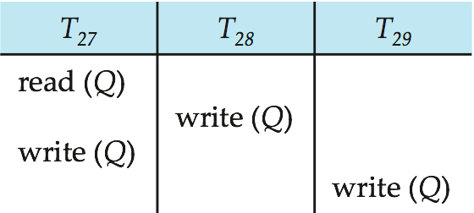
View Serializability (Cont.)
A schedule S is view serializable if it is view equivalent to a serial schedule.
Every conflict serializable schedule is also view serializable.
Below is a schedule which is view-serializable but not conflict serializable.
What serial schedule is above equivalent to?
Every view serializable schedule that is not conflict serializable has blind writes.

Slide 82
Test for View Serializability
The precedence graph test for conflict serializability cannot be used directly to test for view serializability.
Extension to test for view serializability has cost exponential in the size of the precedence graph.
The problem of checking if a schedule is view serializable falls in the class of NP-complete problems.
Thus, existence of an efficient algorithm is extremely unlikely.
However ,practical algorithms that just check some sufficient conditions for view serializability can still be used.

Slide 83
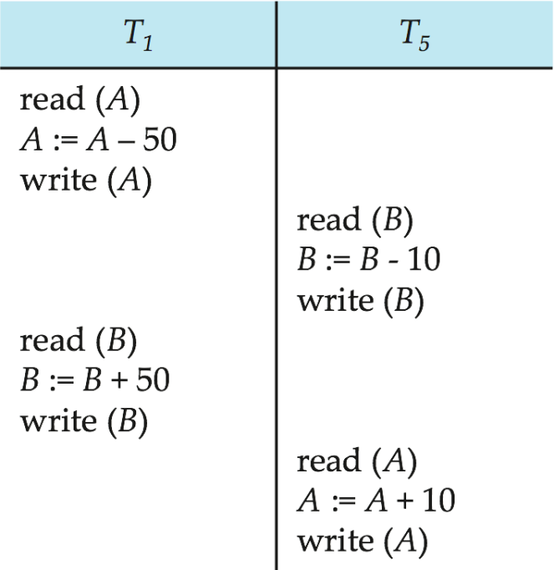
More Complex Notions of Serializability
The schedule below produces the same outcome as the serial schedule < T₁, T₅ >, yet is not conflict equivalent or view equivalent to it.
If we start with A = 1000 and B = 2000, the final result is 960 and 2040
Determining such equivalence requires analysis of operations other than read and write.

Slide 84
Log-Based Recovery
The log is a sequence of records. Log of each transaction is maintained in some stable storage so that if any failure occurs, then it can be recovered from there.
If any operation is performed on the database, then it will be recorded in the log.
But the process of storing the logs should be done before the actual transaction is applied in the database.
Let's assume there is a transaction to modify the City of a student. The following logs are written for this transaction.
When the transaction is initiated, then it writes 'start' log.
<Tn, Start>

Slide 85
When the transaction modifies the City from 'Noida' to 'Bangalore', then another log is written to the file.
<Tn, City, 'Noida', 'Bangalore' >
When the transaction is finished, then it writes another log to indicate the end of the transaction.
<Tn, Commit>

Slide 86
There are two approaches to modify the database:
1. Deferred database modification:
The deferred modification technique occurs if the transaction does not modify the database until it has committed.
In this method, all the logs are created and stored in the stable storage, and the database is updated when a transaction commits.
2. Immediate database modification:
The Immediate modification technique occurs if database modification occurs while the transaction is still active.
In this technique, the database is modified immediately after every operation. It follows an actual database modification.

Slide 87
Recovery using Log records
When the system is crashed, then the system consults the log to find which transactions need to be undone and which need to be redone.
If the log contains the record <Ti, Start> and <Ti, Commit> or <Ti, Commit>, then the Transaction Ti needs to be redone.
If log contains record<T_{n}, Start> but does not contain the record either <Ti, commit> or <Ti, abort>, then the Transaction Ti needs to be undone

Slide 88
Checkpoint
The checkpoint is a type of mechanism where all the previous logs are removed from the system and permanently stored in the storage disk.
The checkpoint is like a bookmark. While the execution of the transaction, such checkpoints are marked, and the transaction is executed then using the steps of the transaction, the log files will be created.
When it reaches to the checkpoint, then the transaction will be updated into the database, and till that point, the entire log file will be removed from the file. Then the log file is updated with the new step of transaction till next checkpoint and so on.
The checkpoint is used to declare a point before which the DBMS was in the consistent state, and all transactions were committed.

Slide 89
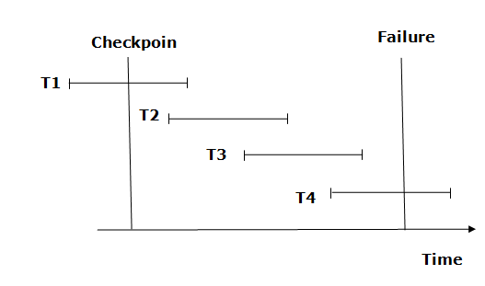
Recovery using Checkpoint
In the following manner, a recovery system recovers the database from this failure:

Slide 90
The recovery system reads log files from the end to start. It reads log files from T4 to T1.
Recovery system maintains two lists, a redo-list, and an undo-list.
The transaction is put into redo state if the recovery system sees a log with <Tn, Start> and <Tn, Commit> or just <Tn, Commit>. In the redo-list and their previous list, all the transactions are removed and then redone before saving their logs.
For example: In the log file, transaction T2 and T3 will have <Tn, Start> and <Tn, Commit>. The T1 transaction will have only <Tn, commit> in the log file. That's why the transaction is committed after the checkpoint is crossed. Hence it puts T1, T2 and T3 transaction into redo list.
The transaction is put into undo state if the recovery system sees a log with <Tn, Start> but no commit or abort log found. In the undo-list, all the transactions are undone, and their logs are removed.
For example: Transaction T4 will have <Tn, Start>. So T4 will be put into undo list since this transaction is not yet complete and failed amid.

Slide 91
Deadlock in DBMS
A deadlock is a condition where two or more transactions are waiting indefinitely for one another to give up locks. Deadlock is said to be one of the most feared complications in DBMS as no task ever gets finished and is in waiting state forever.

Slide 92
Deadlock in DBMS
A deadlock is a condition where two or more transactions are waiting indefinitely for one another to give up locks. Deadlock is said to be one of the most feared complications in DBMS as no task ever gets finished and is in waiting state forever.
For example: In the student table, transaction T1 holds a lock on some rows and needs to update some rows in the grade table. Simultaneously, transaction T2 holds locks on some rows in the grade table and needs to update the rows in the Student table held by Transaction T1.
Now, the main problem arises. Now Transaction T1 is waiting for T2 to release its lock and similarly, transaction T2 is waiting for T1 to release its lock. All activities come to a halt state and remain at a standstill. It will remain in a standstill until the DBMS detects the deadlock and aborts one of the transactions.

Slide 93
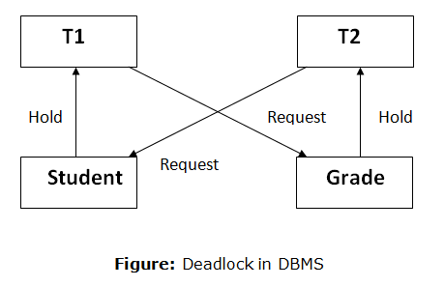

Slide 94
Deadlock Avoidance
When a database is stuck in a deadlock state, then it is better to avoid the database rather than aborting or restating the database. This is a waste of time and resource.
Deadlock avoidance mechanism is used to detect any deadlock situation in advance. A method like "wait for graph" is used for detecting the deadlock situation but this method is suitable only for the smaller database. For the larger database, deadlock prevention method can be used.
Deadlock Detection
In a database, when a transaction waits indefinitely to obtain a lock, then the DBMS should detect whether the transaction is involved in a deadlock or not. The lock manager maintains a Wait for the graph to detect the deadlock cycle in the database.

Slide 95
Deadlock Avoidance
When a database is stuck in a deadlock state, then it is better to avoid the database rather than aborting or restating the database. This is a waste of time and resource.
Deadlock avoidance mechanism is used to detect any deadlock situation in advance. A method like "wait for graph" is used for detecting the deadlock situation but this method is suitable only for the smaller database. For the larger database, deadlock prevention method can be used.
Deadlock Detection
In a database, when a transaction waits indefinitely to obtain a lock, then the DBMS should detect whether the transaction is involved in a deadlock or not. The lock manager maintains a Wait for the graph to detect the deadlock cycle in the database.

Slide 96
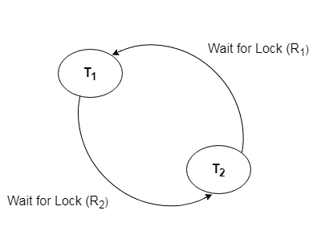

Slide 97
Deadlock Prevention
Deadlock prevention method is suitable for a large database. If the resources are allocated in such a way that deadlock never occurs, then the deadlock can be prevented.
The Database management system analyzes the operations of the transaction whether they can create a deadlock situation or not. If they do, then the DBMS never allowed that transaction to be executed.
Wait-Die scheme
In this scheme, if a transaction requests for a resource which is already held with a conflicting lock by another transaction then the DBMS simply checks the timestamp of both transactions. It allows the older transaction to wait until the resource is available for execution.
Let's assume there are two transactions Ti and Tj and let TS(T) is a timestamp of any transaction T. If T2 holds a lock by some other transaction and T1 is requesting for resources held by T2 then the following actions are performed by DBMS

Slide 98
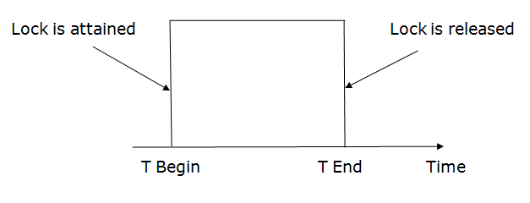
Check if TS(Ti) < TS(Tj) - If Ti is the older transaction and Tj has held some resource, then Ti is allowed to wait until the data-item is available for execution. That means if the older transaction is waiting for a resource which is locked by the younger transaction, then the older transaction is allowed to wait for resource until it is available.
Check if TS(T_{i}) < TS(Tj) - If Ti is older transaction and has held some resource and if Tj is waiting for it, then Tj is killed and restarted later with the random delay but with the same timestamp.
Wound wait scheme
In wound wait scheme, if the older transaction requests for a resource which is held by the younger transaction, then older transaction forces younger one to kill the transaction and release the resource. After the minute delay, the younger transaction is restarted but with the same timestamp.
If the older transaction has held a resource which is requested by the Younger transaction, then the younger transaction is asked to wait until older releases it.

Slide 99
Lock-Based Protocol
In this type of protocol, any transaction cannot read or write data until it acquires an appropriate lock on it. There are two types of lock:
1. Shared lock:
It is also known as a Read-only lock. In a shared lock, the data item can only read by the transaction.
It can be shared between the transactions because when the transaction holds a lock, then it can't update the data on the data item.
2. Exclusive lock:
In the exclusive lock, the data item can be both reads as well as written by the transaction.
This lock is exclusive, and in this lock, multiple transactions do not modify the same data simultaneously.

Slide 100
There are four types of lock protocols available:
1. Simplistic lock protocol
It is the simplest way of locking the data while transaction. Simplistic lock-based protocols allow all the transactions to get the lock on the data before insert or delete or update on it. It will unlock the data item after completing the transaction.
2. Pre-claiming Lock Protocol
Pre-claiming Lock Protocols evaluate the transaction to list all the data items on which they need locks.
Before initiating an execution of the transaction, it requests DBMS for all the lock on all those data items.
If all the locks are granted then this protocol allows the transaction to begin. When the transaction is completed then it releases all the lock.
If all the locks are not granted then this protocol allows the transaction to rolls back and waits until all the locks are granted.

Slide 101
Two-phase locking (2PL)
The two-phase locking protocol divides the execution phase of the transaction into three parts.
In the first part, when the execution of the transaction starts, it seeks permission for the lock it requires.
In the second part, the transaction acquires all the locks. The third phase is started as soon as the transaction releases its first lock.
In the third phase, the transaction cannot demand any new locks. It only releases the acquired locks

Slide 102
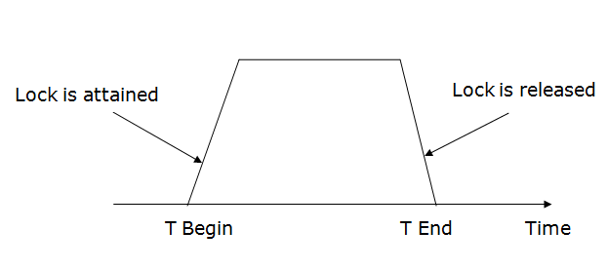

Slide 103
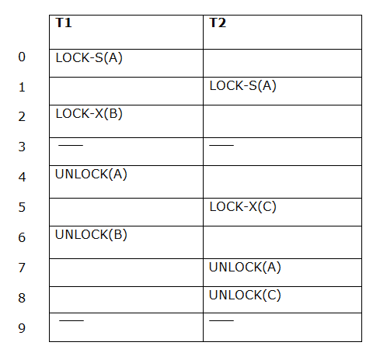
There are two phases of 2PL:
Growing phase: In the growing phase, a new lock on the data item may be acquired by the transaction, but none can be released.
Shrinking phase: In the shrinking phase, existing lock held by the transaction may be released, but no new locks can be acquired.
In the below example, if lock conversion is allowed then the following phase can happen:
Upgrading of lock (from S(a) to X (a)) is allowed in growing phase.
Downgrading of lock (from X(a) to S(a)) must be done in shrinking phase.
Example:

Slide 104
The following way shows how unlocking and locking work with 2-PL.
Transaction T1:
Growing phase: from step 1-3
Shrinking phase: from step 5-7
Lock point: at 3
Transaction T2:
Growing phase: from step 2-6
Shrinking phase: from step 8-9
Lock point: at 6

Slide 105
4. Strict Two-phase locking (Strict-2PL)
The first phase of Strict-2PL is similar to 2PL. In the first phase, after acquiring all the locks, the transaction continues to execute normally.
The only difference between 2PL and strict 2PL is that Strict-2PL does not release a lock after using it.
Strict-2PL waits until the whole transaction to commit, and then it releases all the locks at a time.
Strict-2PL protocol does not have shrinking phase of lock release.

Slide 106
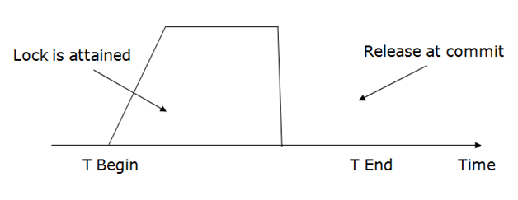
It does not have cascading abort as 2PL does.

Slide 107
Timestamp Ordering Protocol
The Timestamp Ordering Protocol is used to order the transactions based on their Timestamps. The order of transaction is nothing but the ascending order of the transaction creation.
The priority of the older transaction is higher that's why it executes first. To determine the timestamp of the transaction, this protocol uses system time or logical counter.
The lock-based protocol is used to manage the order between conflicting pairs among transactions at the execution time. But Timestamp based protocols start working as soon as a transaction is created.
Let's assume there are two transactions T1 and T2. Suppose the transaction T1 has entered the system at 007 times and transaction T2 has entered the system at 009 times. T1 has the higher priority, so it executes first as it is entered the system first.
The timestamp ordering protocol also maintains the timestamp of last 'read' and 'write' operation on a data.

Slide 108
Basic Timestamp ordering protocol works as follows:
1. Check the following condition whenever a transaction Ti issues a Read (X) operation:
If W_TS(X) >TS(Ti) then the operation is rejected.
If W_TS(X) <= TS(Ti) then the operation is executed.
Timestamps of all the data items are updated.
2. Check the following condition whenever a transaction Ti issues a Write(X) operation:
If TS(Ti) < R_TS(X) then the operation is rejected.
If TS(Ti) < W_TS(X) then the operation is rejected and Ti is rolled back otherwise the operation is executed.
Where,
TS(TI) denotes the timestamp of the transaction Ti.
R_TS(X) denotes the Read time-stamp of data-item X.
W_TS(X) denotes the Write time-stamp of data-item X.

Slide 109
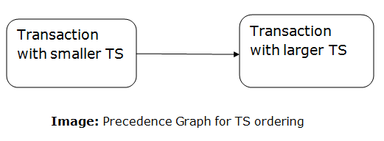
Advantages and Disadvantages of TO protocol:
TO protocol ensures serializability since the precedence graph is as follows:
TS protocol ensures freedom from deadlock that means no transaction ever waits.
But the schedule may not be recoverable and may not even be cascade- free.

Slide 110
Validation Based Protocol
Validation phase is also known as optimistic concurrency control technique. In the validation based protocol, the transaction is executed in the following three phases:
Read phase: In this phase, the transaction T is read and executed. It is used to read the value of various data items and stores them in temporary local variables. It can perform all the write operations on temporary variables without an update to the actual database.
Validation phase: In this phase, the temporary variable value will be validated against the actual data to see if it violates the serializability.
Write phase: If the validation of the transaction is validated, then the temporary results are written to the database or system otherwise the transaction is rolled back.
Here each phase has the following different timestamps:
Start(Ti): It contains the time when Ti started its execution.
Validation (T_{i}): It contains the time when Ti finishes its read phase and starts its validation phase.
Finish(Ti): It contains the time when Ti finishes its write phase.
This protocol is used to determine the time stamp for the transaction for serialization using the time stamp of the validation phase, as it is the actual phase which determines if the transaction will commit or rollback.
Hence TS(T) = validation(T).
The serializability is determined during the validation process. It can't be decided in advance.
While executing the transaction, it ensures a greater degree of concurrency and also less number of conflicts.
Thus it contains transactions which have less number of rollbacks.

Slide 111
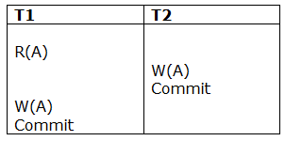
Thomas write Rule
Thomas Write Rule provides the guarantee of serializability order for the protocol. It improves the Basic Timestamp Ordering Algorithm.
The basic Thomas write rules are as follows:Figure: A Serializable Schedule that is not Conflict Serializable
If TS(T) < R_TS(X) then transaction T is aborted and rolled back, and operation is rejected.
If TS(T) < W_TS(X) then don't execute the W_item(X) operation of the transaction and continue processing.
If neither condition 1 nor condition 2 occurs, then allowed to execute the WRITE operation by transaction Ti and set W_TS(X) to TS(T).
If we use the Thomas write rule then some serializable schedule can be permitted that does not conflict serializable as illustrate by the schedule in a given figure:

Slide 112
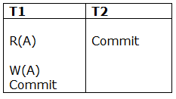
In the above figure, T1's read and precedes T1's write of the same data item. This schedule does not conflict serializable.
Thomas write rule checks that T2's write is never seen by any transaction. If we delete the write operation in transaction T2, then conflict serializable schedule can be obtained which is shown in below figure.
Figure: A Conflict Serializable Schedule

Slide 113
Multiple Granularity
Let's start by understanding the meaning of granularity.
Granularity: It is the size of data item allowed to lock.
Multiple Granularity:
It can be defined as hierarchically breaking up the database into blocks which can be locked.
The Multiple Granularity protocol enhances concurrency and reduces lock overhead.
It maintains the track of what to lock and how to lock.
It makes easy to decide either to lock a data item or to unlock a data item. This type of hierarchy can be graphically represented as a tree.
For example: Consider a tree which has four levels of nodes.
The first level or higher level shows the entire database.
The second level represents a node of type area. The higher level database consists of exactly these areas.
The area consists of children nodes which are known as files. No file can be present in more than one area.
Finally, each file contains child nodes known as records. The file has exactly those records that are its child nodes. No records represent in more than one file.
Hence, the levels of the tree starting from the top level are as follows:
Database
Area
File
Record

Slide 114
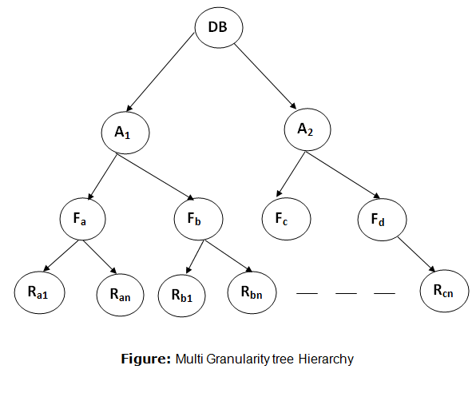

Slide 115
In this example, the highest level shows the entire database. The levels below are file, record, and fields.
There are three additional lock modes with multiple granularity:
Intention Mode Lock
Intention-shared (IS): It contains explicit locking at a lower level of the tree but only with shared locks.
Intention-Exclusive (IX): It contains explicit locking at a lower level with exclusive or shared locks.
Shared & Intention-Exclusive (SIX): In this lock, the node is locked in shared mode, and some node is locked in exclusive mode by the same transaction.
Compatibility Matrix with Intention Lock Modes: The below table describes the compatibility matrix for these lock modes:

Slide 116
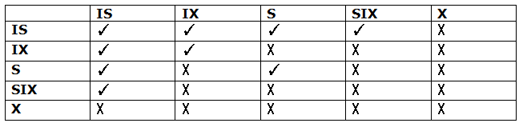
It uses the intention lock modes to ensure serializability. It requires that if a transaction attempts to lock a node, then that node must follow these protocols:
Transaction T1 should follow the lock-compatibility matrix.
Transaction T1 firstly locks the root of the tree. It can lock it in any mode.
If T1 currently has the parent of the node locked in either IX or IS mode, then the transaction T1 will lock a node in S or IS mode only.
If T1 currently has the parent of the node locked in either IX or SIX modes, then the transaction T1 will lock a node in X, SIX, or IX mode only.
If T1 has not previously unlocked any node only, then the Transaction T1 can lock a node.
If T1 currently has none of the children of the node-locked only, then Transaction T1 will unlock a node.
Observe that in multiple-granularity, the locks are acquired in top-down order, and locks must be released in bottom-up order.
If transaction T1 reads record R_{a9} in file F_{a}, then transaction T1 needs to lock the database, area A₁ and file F_{a} in IX mode. Finally, it needs to lock R_{a2} in S mode.
If transaction T2 modifies record R_{a9} in file F_{a}, then it can do so after locking the database, area A₁ and file F_{a} in IX mode. Finally, it needs to lock the R_{a9} in X mode.
If transaction T3 reads all the records in file F_{a}, then transaction T3 needs to lock the database, and area A in IS mode. At last, it needs to lock F_{a} in S mode.
If transaction T4 reads the entire database, then T4 needs to lock the database in S mode.

